Slide 1
Data Engineering
Instructor: Dr. Ibrahim Al-Haol
Student: Anas Obeidat
Subject: NiFi Flow to convert CSV to JSON

Slide 2
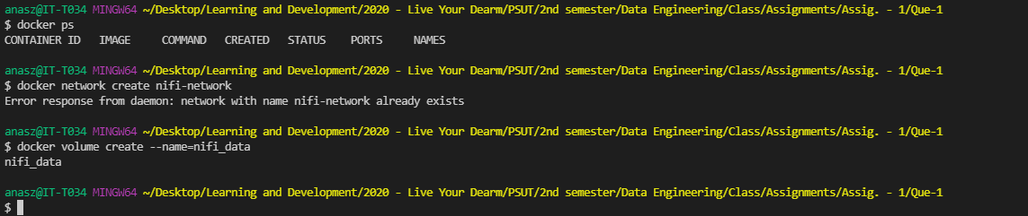
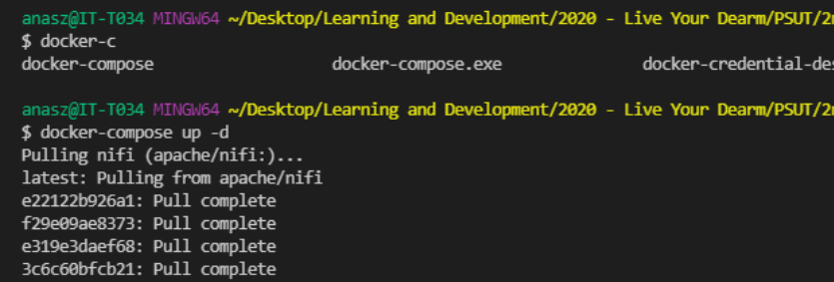
Create NiFi Network, Volume and Install Docker-Compose

Slide 3
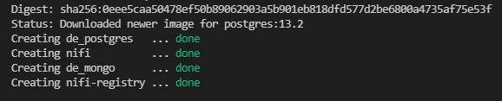
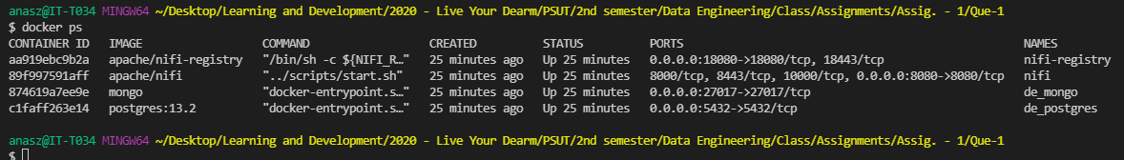
Docker Compose Installed Successfully

Slide 4
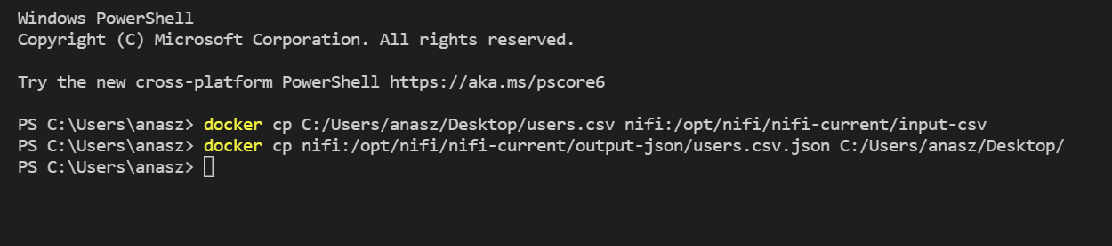
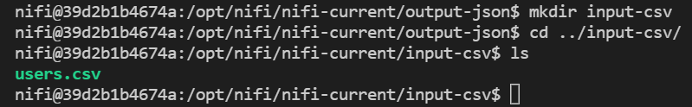
Access NiFi Server, Create Folders, Copy CSV to NiFi

Slide 5
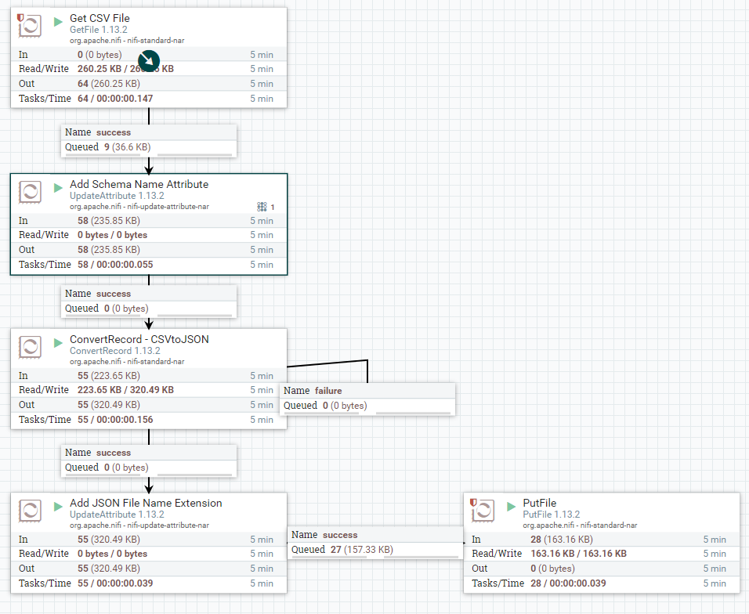
Flow

Slide 6
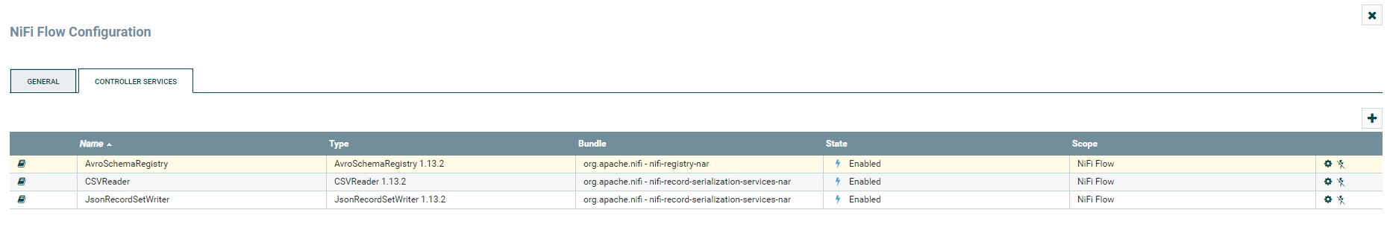
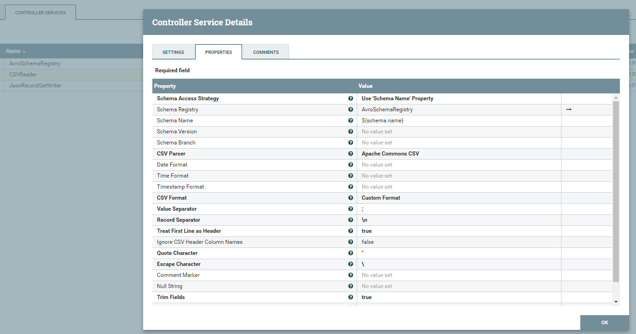
NiFi Flow Configuration

Slide 7
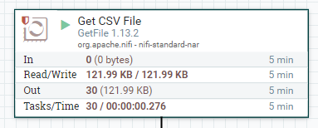
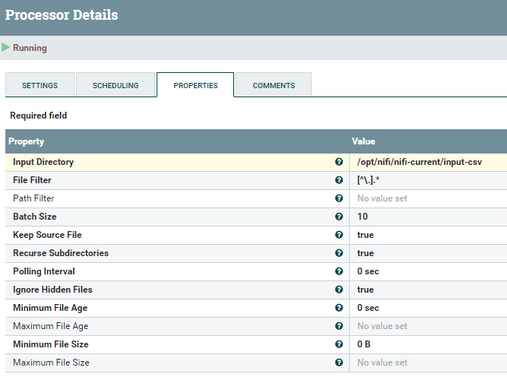
Get CSV File Processor, Change the Directory to Read CSV

Slide 8
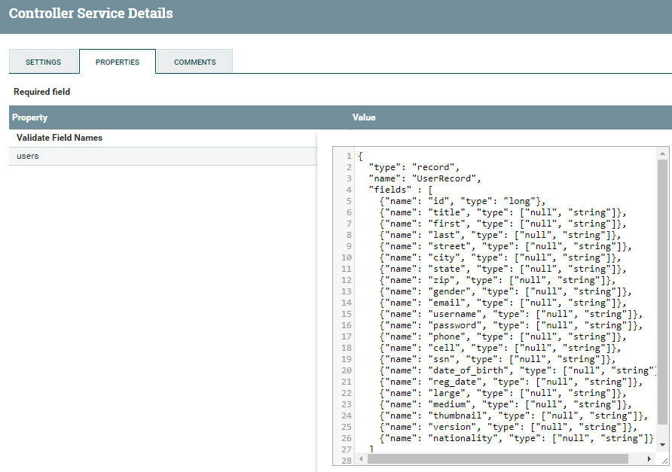
Reading CSV File in the Configured Directory

Slide 9
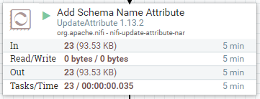
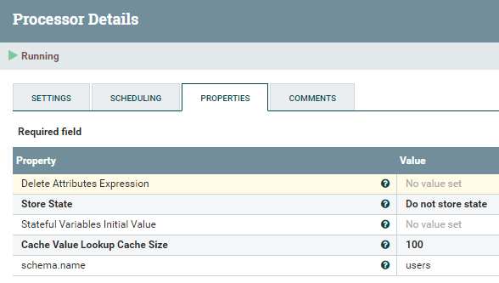
Add Schema Attribute with Value

Slide 10
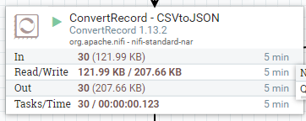
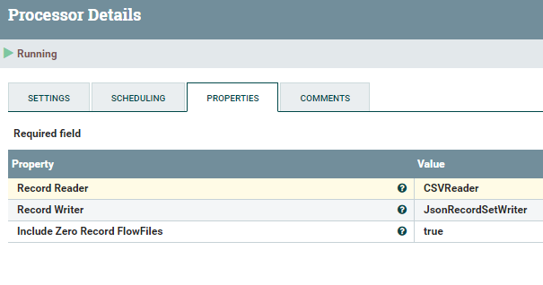
Convert CVS to JSON

Slide 11
Viewing JSON File

Slide 12
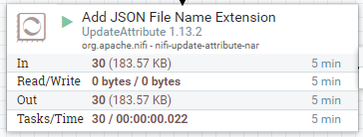
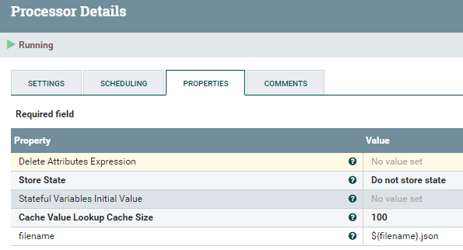
Add JSON Extension to the CSV File Name

Slide 13
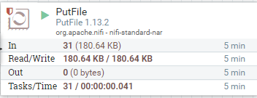

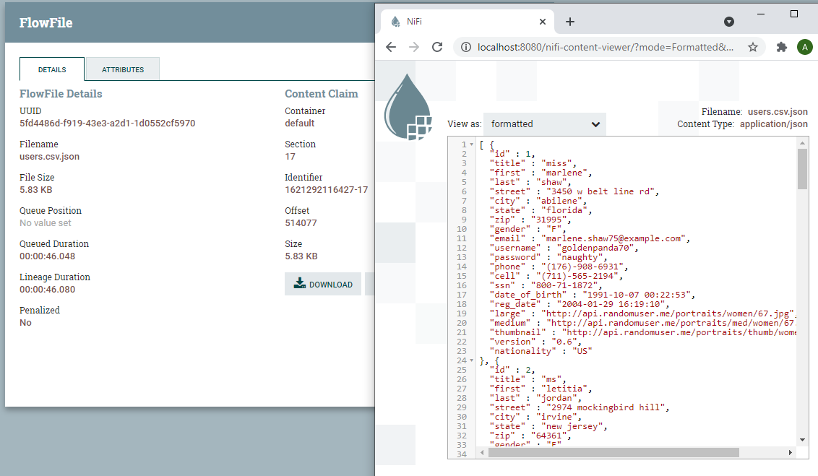
Put JSON File in the Configured Path

